Slide 1
Assessment of Entrepreneurial Opportunities

Slide 2
The Challenge of New-Venture Start-Ups
New Venture Formation
  The number of new-venture start-ups has been consistently high at reports of more than 400,000
  new firms in the United States every year since 2010.
Ideas for Potential New Businesses
  The U.S. Patent Office currently receives more than 500,000 patent applications per year.

Slide 3
Pitfalls in Selecting New Ventures
Lack of objective evaluation
No real insight into the market
Inadequate understanding of technical requirements
Poor financial understanding
Lack of venture uniqueness
Ignorance of legal issues

Slide 4


Reasons for Starting a Venture
Personal Characteristics
The Environment
The
Venture
Entrepreneurial
Motivations

Slide 5
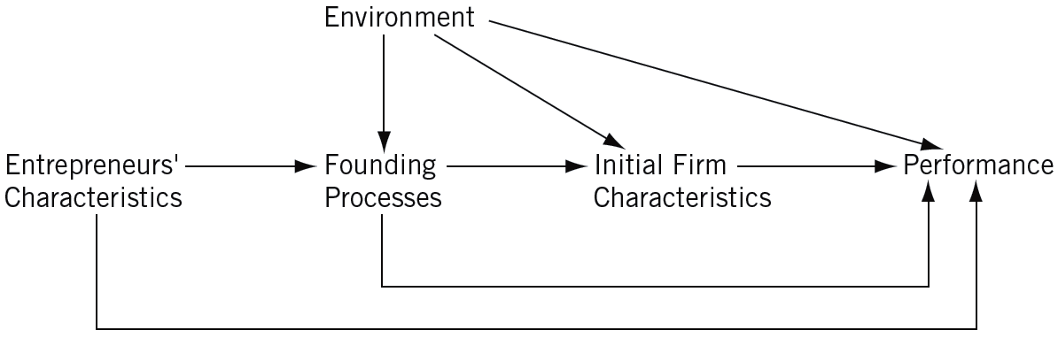
^{Figure} 6.1 The Elements Affecting New-Venture Performance
Source: Arnold C. Cooper, “Challenges in Predicting New Firm Performance,” Journal of Business Venturing 8, no. 3 (1993): 243. Reprinted with permission.

Slide 6
Phases in New-Venture Start-ups
Prestart-up Phase
  Begins with an idea for the venture and ends when the doors are opened for business.
Start-up Phase
  Commences with the initiation of sales activity and the delivery of products and services, and ends when the business is firmly established and beyond short-term threats to survival.
Poststart-up Phase
  Lasts until the venture is terminated or the surviving organizational entity is no longer controlled by an entrepreneur.

Slide 7
Critical Factors for
New-Venture Development
Uniqueness
  Range can be considerable, extending from fairly routine to highly nonroutine
Investment
  Capital investment to start a new venture can vary from some industries less than $100,000 to other industries requiring millions of dollars.
Growth of Sales
  Lifestyle ventures
  Small profitable ventures
  High-growth ventures

Slide 8
Critical Factors for
New-Venture Development (cont’d)
Product Availability
  Availability of a salable good or service at the time the venture opens its doors.
  Sometimes there is a problem because the product or service is still in development and needs further modification or testing. For example, “bugs” in a software firm.
Customer Availability
  A critical consideration is how long it will take to determine who the customers are, as well as their buying habits.

Slide 9
^{Table} 6.1 A New-Venture Idea Checklist
Basic Feasibility of the Venture
1. Can the product or service work?
2. Is it legal?
Competitive Advantages of the Venture
1. What specific competitive advantages will the product or service offer?
2. What are the competitive advantages of the companies already in business?
3. How are the competitors likely to respond?
4. How will the initial competitive advantage be maintained?
Buyer Decisions in the Venture
1. Who are the customers likely to be?
2. How much will each customer buy, and how many customers are there?
3. Where are these customers located, and how will they be serviced?
Marketing of the Goods and Services
1. How much will be spent on advertising and selling?
2. What share of market will the company capture? By when?
3. Who will perform the selling functions?
4. How will prices be set? How will they compare with the competition’s prices?
5. How important is location, and how will it be determined?
6. What distribution channels will be used—wholesale, retail, agents, direct mail?
7. What are the sales targets? By when should they be met?
8. Can any orders be obtained before starting the business? How many? For what total amount?
Source: Karl H. Vesper, New Venture Strategies, (Revised Edition), 1st Edition, © 1990. Reprinted by permission of Pearson Education, Inc. Upper Saddle River, NJ.

Slide 10
^{Table} 6.1 A New-Venture Idea Checklist (cont’d)
Production of the Goods and Services
1. Will the company make or buy what it sells? Or will it use a combination of these two strategies?
2. Are sources of supplies available at reasonable prices?
3. How long will delivery take?
4. Have adequate lease arrangements for premises been made?
5. Will the needed equipment be available on time?
6. Do any special problems with plant setup, clearances, or insurance exist? How will they be resolved?
7. How will quality be controlled?
8. How will returns and servicing be handled?
9. How will pilferage, waste, spoilage, and scrap be controlled?
Staffing Decisions in the Venture
1. How will competence in each area of the business be ensured?
2. Who will have to be hired? By when? How will they be found and recruited?
3. Will a banker, lawyer, accountant, or other advisers be needed?
4. How will replacements be obtained if key people leave?
5. Will special benefit plans have to be arranged?
Control of the Venture
1. What records will be needed? When?
2. Will any special controls be required? What are they? Who will be responsible for them?
Source: Karl H. Vesper, New Venture Strategies, (Revised Edition), 1st Edition, © 1990. Reprinted by permission of Pearson Education, Inc. Upper Saddle River, NJ.

Slide 11
^{Table} 6.1 A New-Venture Idea Checklist (cont’d)
Financing the Venture
How much will be needed for development of the product or service?
How much will be needed for setting up operations?
How much will be needed for working capital?
Where will the money come from? What if more is needed?
Which assumptions in the financial forecasts are most uncertain?
What will be the return on equity, or sales, and how does it compare with the rest of the industry?
When and how will investors get their money back?
What will be needed from the bank, and what is the bank’s response?
Source: Karl H. Vesper, New Venture Strategies, (Revised Edition), 1st Edition, © 1990. Reprinted by permission of Pearson Education, Inc. Upper Saddle River, NJ.

Slide 12
Why New Ventures Fail
Product/Market Problems
  Poor timing
  Product design problems
  Inappropriate distribution strategy
  Unclear business definition
  Overreliance on one customer
Financial Difficulties
  Initial undercapitalization
  Assuming debt too early
  Venture capital relationship problems
Managerial Problems
  Concept of a team approach
  Human resource problems

Slide 13
^{Table} 6.2 Types and Classes of First-Year Problems
Obtaining external financing
  Obtaining financing for growth
  Other or general financing problems
Internal financial management
  Inadequate working capital
  Cash-flow problems
  Other or general financial management problems
Sales/marketing
  Low sales
  Dependence on one or few clients/customers
  Marketing or distribution channels
  Promotion/public relations/advertising
  Other or general marketing problems
Product development
  Developing products/services
  Other or general product development problems
Production/operations management
  Establishing or maintaining quality control
  Raw materials/resources/supplies
  Other or general production/operations management problems
General management
  Lack of management experience
  Only one person/no time
  Managing/controlling growth
  Administrative problems
  Other or general management problems
Human resource management
  Recruitment/selection
  Turnover/retention
  Satisfaction/morale
  Employee development
  Other or general human resource management problems
Economic environment
  Poor economy/recession
  Other or general economic environment problems
Regulatory environment
  Insurance
Source: David E. Terpstra and Philip D. Olson, “Entrepreneurial Start-up and Growth: A Classification of Problems,” Entrepreneurship Theory and Practice 17, no. 3 (Spring 1993): 19. Reproduced with permission of John Wiley & Sons Ltd.

Slide 14
New Venture Failure Prediction Model
Role of profitability and cash flows
Role of debt
Combination of both
Role of initial size
Role of velocity of capital
Role of control

Slide 15
^{Table} 6.3 The Failure Process of a Newly Founded Firm
Extremely high indebtedness (poor static solidity) and small size
Too slow velocity of capital, too fast growth, too poor profitability (as compared to the budget), or some combination of these
Unexpected lack of revenue financing (poor dynamic liquidity)
Poor static liquidity and debt service ability (dynamic solidity)
Source: Erkki K. Laitinen, “Prediction of Failure of a Newly Founded Firm,” Journal of Business Venturing 7, no. 4(1992): 326-28. Reprinted with permission.

Slide 16
Feasibility Criteria Approach
Assessing the viability of a venture:
  Is it proprietary?
  Are initial production costs realistic?
  Are the initial marketing costs realistic?
  Does the product have potential for very high margins?
  Is the time required to get to market and to reach the break-even point realistic?
  Is the potential market large?
  Is the product the first of a growing family?
  Does an initial customer exist?
  Are the development costs and calendar times realistic?
  Is this a growing industry?
  Can the product—and the need for it—be understood by the financial community?

Slide 17
The Traditional Venture Evaluation Process
Profile Analysis Approach
  Identifying and investigating the financial, marketing, organizational, and human resource variables prior to start-up.
The Feasibility Criteria Approach
  The use of a criteria selection list to gain insights.
Comprehensive Feasibility Approach
  Incorporates external factors in addition to those included in the criteria questions.

Slide 18
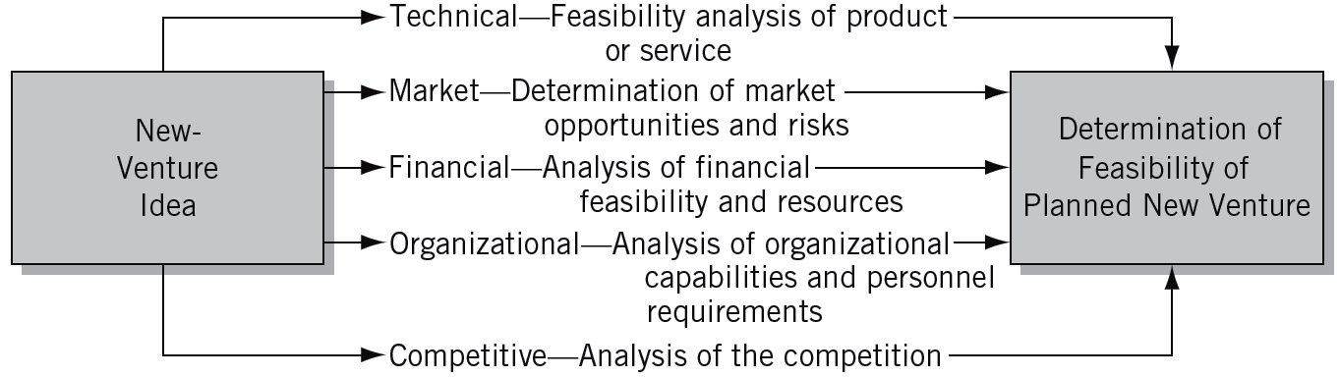
^{Figure} 6.2 Key Areas for Assessing the Feasibility of a New Venture

Slide 19
The Contemporary Methodologies for Venture Evaluation
Design Methodology
  Universities are now building programs that take a general approach to design rather than concentrating it in just technical schools like architecture and engineering.
  Takes an initial concept idea and develops a proof of concept that elicits feedback from relevant stakeholders.
Design-Centered Entrepreneurship
  Entrepreneurs apply design methods in four action stages of developing an opportunity.

Slide 20
The Contemporary Methodologies for Venture Evaluation (cont’d)
The Lean Start-up Methodology
  Provides a scientific approach to creating early venture concepts and delivers a desired product to customers’ hand faster.
  Reduces waste by maximizing the time and effort that goes into an incorrect hypothesis by putting a lean-focused process on the development of your product or service.
  Entrepreneurs must work to gather and incorporate customer feedback early and often.

Slide 21
The Design Methodology
A process that shapes and converts ideas into form, whether that is a plan of action, an experience, or a physical thing.
An initial concept taken and developed into a proof of concept that elicits
  Proof of Concept Feasibility
  Proof of Concept Desirability
  Proof of Concept Visibility

Slide 22
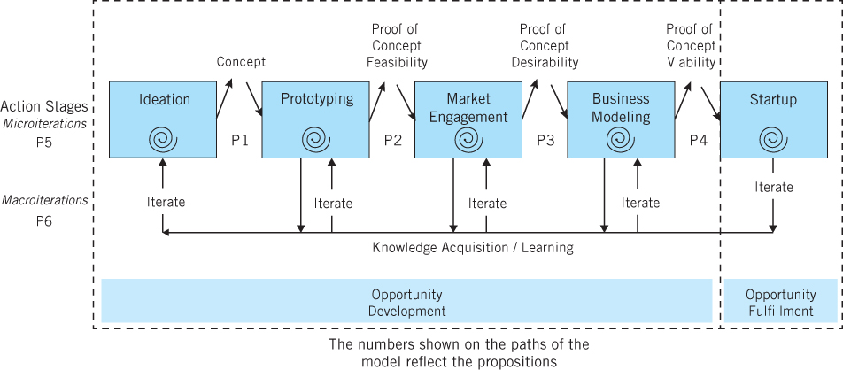
^{Figure} 6.3 Design-Centered Entrepreneurship
Source: Michael G. Goldsby, Donald F. Kuratko, Matthew R. Marvel, and Thomas Nelson, “Introducing Design-Centered Entrepreneurship to Entrepreneurship Education,” Journal of Small Business Management (2015). In Press.

Slide 23
The Design-Centered Entrepreneurship
Taking action and learning that culminates in a venture concept for further development.
Applying a prototyping stage that addresses the technical issues of the concept, and ensures that a feasible product or service can be made and delivered.
Incorporating microiterations (within each action stage to improve the outcome) and macroiterations (moving from one particular action stage back to a previous stage for further development).

Slide 24
Key Lean Start-Up Terminology
Minimum Viable Product (MVP):
  Three A’s of Metrics
    Actionable
    Accessible
    Auditable
  Pivot
  Build-Measure-Learn Feedback Loop
  Validated Learning

Slide 25
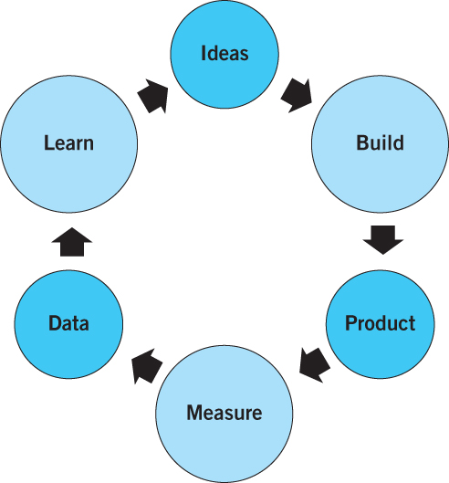
^{Figure} 6.4 Build-Measure-Learn Feedback Loop

Slide 26
Key Terms
comprehensive feasibility approach
critical factors
customer availability
external problems
design-centered entrepreneurship
design methodology
failure prediction model
feasibility criteria approach
growth of sales
growth stage
high-growth venture
internal problems
lean start-up methodology
lifestyle venture
macroiteration
marketability
microiteration
minimum viable product (MVP)
pivot
product availability
prototyping
small profitable venture
start-up problems
technical feasibility
uniqueness
validated learning

